Slide 1

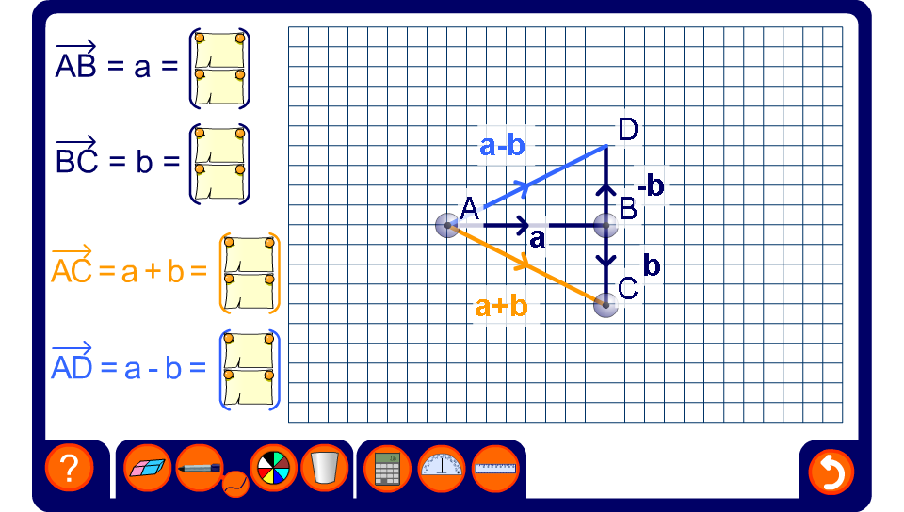


Adding and subtracting vectors
Notes:
Drag the points A, B, C and D to demonstrate the addition and subtraction of vectors.

